Slide 1
UML Class Diagrams
Dr Simon Scola
EurIng Alex Fedorec, Dr Chaoying Ma, Peter Dench

Slide 2

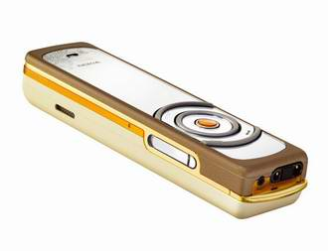


Lectures / ground rules

Slide 3
Recap: What we covered last week
A Brief history of UML
A quick overview of UML notation
Fundamental OO concepts
  State, Behavior, Identity
Message passing
Objects or Classes
Noun detection design technique

Slide 4
Recap: What is an Object?
Simply put.. An object is a thing which has behaviour, state and identity
  Conceptually, an object is a thing you can interact with:
    you can send it various messages and
    it will react
  How it behaves depends on the current internal state of the object, which may change
    For example: as part of the object’s reaction to receiving a message.
  It matters which object you interact with, an object has an identity which distinguishes it from all other objects.

Slide 5

Recap: Classes v Objects
 | Interpretation in the real world | Representation in the model
Object: | An object represents anything in the real world that can be distinctly identified | An object has an identity, a state and a behaviour
Class: | A class represents a set of objects with similar characteristics and behaviour. These objects are called instance of the class. | A class characterizes the structure of states and behaviours that are shared by all its instances.
Simon: Person
Person
Xiaoping Jia, Object-Orientated Software Development Using Java: Principles, Patterns and Frameworks, Second Edition, DePaul University, 2003, ISBN 0321210735

Slide 6
Recap: : classes
Sale
Product
SaleID: long
TotalCost: float
SaleDate: Date
SalesClerk: Person
ProductID: int
Name: String
Description: String
Supplier: String
Price: float
Customer
CustomerID: long
FirstName: String
LastName: String
Address: String
Postcode: String
Email: String

Slide 7
This week

Slide 8
This weeks topics
An OO (UML) approach to analysis / design
Class notation
  Association (composition / aggregation)
  Multiplicity
  Specialization / Generalization

Slide 9
An OO Analysis & Design approach
Decompose a complex system (divide and conquer)
  a system is made up of things
    Determine what are the things, i.e. What are the objects?
    Determine what attributes (data) an object is made up of
    Determine how things relate to each other/
Determine what the objects do (behaviour/state)
Determine how the objects interact
  (message passing)
UML provides us with a notation to analyse a problem so we can document the above

Slide 10
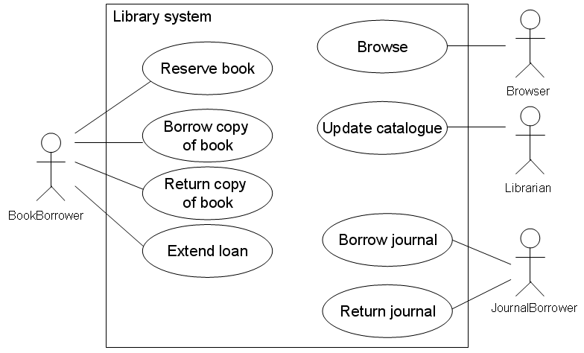
An OO Analysis & Design approach
(First) Use-case diagrams (i.e. behaviour)
  Capture the behaviour (requirements) of the system for a scenario
  Represent a starting point for further analysis

Slide 11

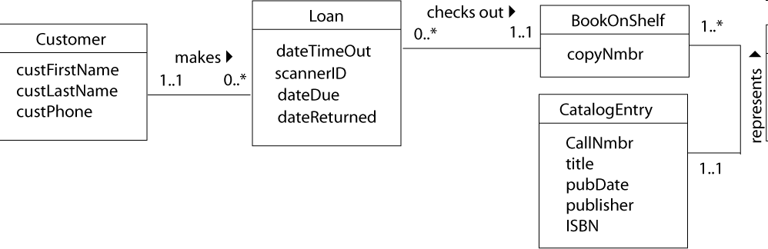
An OO Analysis & Design approach
(Second) Class analysis (i.e. structure)
  What are the classes/objects (things) involved in this system?
  How are they (classes) associated?
  What do they (classes) do?
  What data do they (classes) hold?
BookBrrower

Slide 12

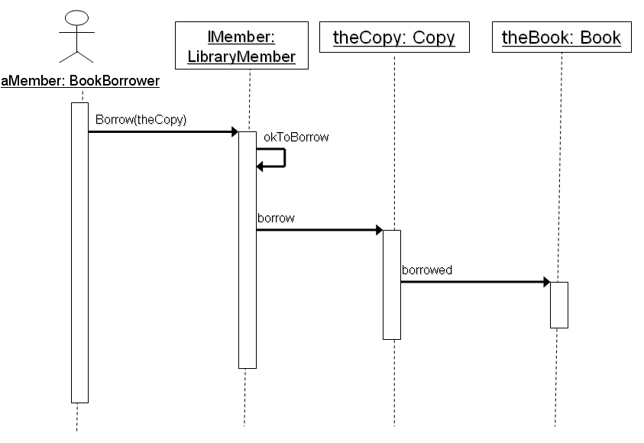
An OO Analysis & Design approach
(in a few weeks) sequence analysis (behaviour)
  How is a scenario (possibly one from a use-case) orchestrated?
  Identify the message passing sequence between classes

Slide 13
An OO Analysis & Design approach
(forth) more refined class analysis
  Revise our initial diagrams
  What more do we know of the classes/objects (things) involved in this system?
    Etc..How are they (classes) associated?
    Etc.. What do they (classes) do?
    Etc.. What data do they (classes) hold?
(fifth) more Behaviour (revise/modify/enchance)
(six) repeat until happy with analysis / design
    Its iterative development

Slide 14
Class vs. object
(Another example)

Slide 15
Class defines structure
Objects represent an instance of ‘the structure’
Classes
Objects
balloon2
balloon1
aBalloon
Balloon
myString
myName
“hello”
“Simon”
String

Slide 16
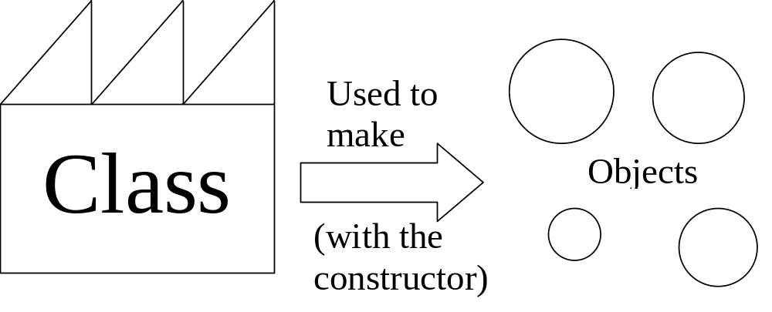
The difference between a class and an object
The factory or
The blueprints
Object instances

Slide 17
A Balloon class
In defining a balloon class we are essentially defining a blueprint for the construction of balloons.
The blueprint (the class) lets us define the characteristics (attributes) of our balloon and any operations that a balloon will carry out.
Balloon blueprint
What information we might need to store?
Size
X coordinate
Y coordinate
What operations we want to do?
changeSize()
display(g)

Slide 18
A Balloon class
Using the blue print constructor we could generate lots of balloons.
Class name
Class attributes
Balloon
Class Methods
size
X
Y
changeSize()
display(g)

Slide 19
A Balloon class
Using the blue print constructor we could generate lots of balloons.
They all have the characteristics of the balloon as stated in our class (our blue print).
All our balloons have Size, X, Y
Balloon
Size
X
Y
changeSize()
display(g)

Slide 20
A Balloon class
Using the blue print constructor we could generate lots of balloons.
They would all have the characteristics of the balloon as stated in our class (our blue print).
But would have their own values
All our balloons have their own data Size, X, Y
Balloon class
Balloon
Size = 7
X=190
Y=30
Size
X
Y
Size
X
Y
changeSize()
display(g)
Size = 4
X=40
Y=100
changeSize()
display(g)
Size = 5
X=100
Y=115

Slide 21
A Balloon class
Using the blue print (i.e. the class) we could generate lots of balloons (i.e. objects).
They would all have the characteristics of the balloon as stated in our class (our blue print).
But would have their own values + the methods of the class
Balloon class
All our balloons have the same behaviour
Balloon
Size = 7
X=190
Y=30
changeSize()
display(g)
Size
X
Y
Size
X
Y
changeSize()
display(g)
Size = 4
X=40
Y=100
changeSize()
display(g)
changeSize()
display(g)
Size = 5
X=100
Y=115
changeSize()
display(g)

Slide 22
A Balloon class
The actual objects generated by a class our known as objects or instances of the class
Each has a unique identity
Balloon3: Balloon
Balloon
Size = 7
X=190
Y=30
changeSize()
display(g)
Size
X
Y
Balloon1: Balloon
Balloon2: Balloon
changeSize()
display(g)
Size = 4
X=40
Y=100
changeSize()
display(g)
Size = 5
X=100
Y=115
changeSize()
display(g)

Slide 23
A Balloon class
Methods can affect the objects
Balloon
Size
X
Y
Balloon3: Balloon
changeSize(4)
Size = 4
X=190
Y=30
changeSize()
display(g)
Size =12
X=190
Y=30
changeSize()
display(g)
Size = 7
X=190
Y=30
changeSize()
display(g)
changeSize()
display(g)
changeSize(12)

Slide 24
A Balloon class
Finally, lets enhance the class description to include some data types
Balloon2: Balloon
Class name
Size = 5
X=100
Y=115
changeSize()
display(g)
Class attributes
Here we have all integers
Balloon
-size: int
-X: int
-Y: int
Class Methods
Classes do not return anything, hence void
+changeSize(): void
+display(g): void
+ means public access
- means private access

Slide 25
Design -> Code
WARNING ! Java code on the next slide
Note: you may have seen this example Java Programming 1

Slide 26
Classes and Object instances
Create the Balloon class:
class Balloon {
private int diameter;
private int xCoord, yCoord;
public Balloon (int initialDiameter, int initialX, int initialY) {
diameter = initialDiameter;
xCoord = initialX;
yCoord = initialY;
}
public void changeSize (int change) {
diameter += change;
}
public void display (Graphics g) {
g.drawOval (xCoord, yCoord, diameter, diameter);
}
}
Class
Balloon
Diameter: int
xCoord: int
yCoord: int
changeSize(int newSize)
display(g)
Objects
Create some objects:
Balloon balloon1 = new Balloon (20, 50, 50);
Balloon balloon2 = new Balloon (20, 100, 10);
Balloon aBalloon = new Balloon (20, 150, 60);

Slide 27
Class diagrams

Slide 28
UML class notation
Class notation is composed of three compartments
First compartment:
Name of the class
Book
title: String
Second compartment:
Attributes
copiesOnShelf(): integer
borrow(c:Copy)
Third compartment:
methods

Slide 29
UML class attributes
Attributes are the data
Attributes are the state of an object
Attributes are the common characteristics of a class
Book
title: String
A book has a Title
Title is a String
In UML the notation is:
Attribute name: data type
Note: Datatype is not correct (but its good enough for now)
Note: Datatype really refers to a class as everything in OO is classes an objects, String, int, float, Person, etc.

Slide 30
UML class attributes
What other attributes are there for a Book?
Instance of a Book
Book
myBook: Book
title: String
author: String
price: float
isbn: String
publisher: String
title = “Window XP”
author = “Bill Gates
price = 27.99
Isbn = “2-5345-53245-2”
Publisher = “Microsoft”
copiesOnShelf(): integer
borrow(c:Copy)
copiesOnShelf(): integer
borrow(c:Copy)

Slide 31
Behaviour / Operations / Methods
Operations/methods are object behavior
Operations/methods provide a means of message passing
Operations/methods are detailed in UML with a signature
copiesOnShelf(): integer
copiesOnShelf(): integer
borrow(c:Copy)
signatures
operation name
operation parameters
return type
Book
title: String
copiesOnShelf(): integer
borrow(c:Copy)
borrow(c:Copy)

Slide 32
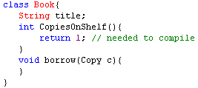
Code example
Let us see how this relates to Java code
UML class description
Java code equivalent
Book
title: String
copiesOnShelf(): integer
borrow(c:Copy)

Slide 33

Another code example
Objects in UML and Code
UML class description of two instances
Java code equivalent
p1 :Point
p2 :Point
x = 0
y = 0
x =10
y = 30

Slide 34
Class diagrams: Abbreviations
It is acceptable to abbreviate
If the abbreviation is sufficient to convey the concepts
Design starts simple and builds detail
Diagram aim is to convey something
  sometimes simplicity conveys more
Book
title
Book
copiesOnShelf()
Borrow(c:copy)
-title: String
#copiesOnShelf(): integer
+borrow(c:Copy)
Book
NOTE: All of these notations are correct UML

Slide 35
Class diagrams: associations
Associations describe relationships between classes
Depicted with a line between the two classes
Associations exist where:
  An object of class A creates an object of class B
  An object of Class A sends a message to object of class B
  An object of Class A receives an Object of Class B as a parameter
  An object of class A has an attribute whose values are object of class B or collections of objects of class B
Customer
Payment

Slide 36
Class diagrams: associations
An object of class A creates an object of class B
Notation:
Meaning:
  Here a class SalesManager creates CustomerAccount
    note the arrow annotation is used to improve readability
    <<create>> is a UML stereo type denoting the nature of the association
SalesManager
<<create>>
CustomerAccount

Slide 37
Class diagrams: associations
2. An object of Class A sends a message to object of class B
Notation:
Meaning:
  Here a class Customer will send a message to the Payment class with a request to make a payment
Customer
Payment

Slide 38
Class diagrams: associations
3. An object of class A has an attribute whose values are an object of class B or collections of objects of class B
Notation:
Meaning:
  A class Order contains a collection of product(s)
Order
Product

Slide 39
Class diagrams: multiplicity
Shows the number of objects involved in the association
  Specified in the form min..max
    2..8 means between 2 and 8 objects involved in the association
  Can specify as exact number,
    i.e. 6 means exactly 6 objects involved in the association
  Asterix * or n means unspecified amount (i.e. infinite max)
    i.e. 2..* means 2 or more objects involved in the association
    i.e. 2..n means 2 or more objects involved in the association
Example Notation
1 or many product objects are associated with an exactly none or more order objects
1..*
0..*
Product
Order

Slide 40
More association: Aggregation
Introduces no new rules it just adds vocabulary to the notation
Aggregation in UML means ‘has a’ or ‘is part of’
Notation:
Meaning:
    between 1 and 6 modules are part of 1 or more programme
1..6
1..*
Module
Programme

Slide 41
More association: Composition
Composition introduces new rules as the objects are intrinsically tied together
Composition in UML means ‘contains’
Composition is a strong form of association
i.e. the life and death of the associated objects coincide
Notation:
Meaning:
Exactly 1 printer object contains between 1 and 2 printBuffer objects
Delete the printer and you also delete the printBuffer
1
1..2
Printer
PrintBuffer

Slide 42
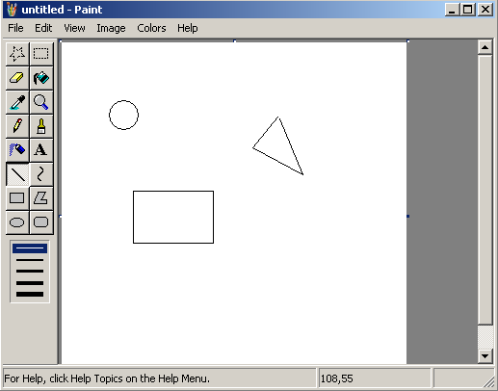
CAD package
CANVAS
SHAPES
Sample class diagram for a CAD drawing package
A UML note
CAD
Canvas
Shape

Slide 43
Class diagrams: Inheritance
Specialization / Generalization
  a sub-class can be defined from a more ‘general’ class
  sub-class can assume the methods and attributes of its more general ‘parent’ class
  A sub-class is comprised of the parent class
  Thus, the sub-class is the parent class with extension
    Specialisation usually extends or adapts the functionality of the parent in some way

Slide 44
Class diagrams: Inheritance
Specialization / Generalization
  For example, a MemberOfStaff class is a generalisation of the sub-class LibraryStaff and also AcademicStaff
  A LibraryStaff is also a MemberOfStaff
  In UML
MemberOfStaff
LibraryStaff
AcademicStaff

Slide 45
Class diagrams: Inheritance
More examples
Shape
Circle
Square
Triangle

Slide 46
Class diagrams: Inheritance
Notation:
Meaning:
    Circle is a Shape
    Circle is everything a Shape is with the extra specialisation of a radius attribute
Shape
Circle
x: int
y: int
radius: int
display(): void

Slide 47
Specialisation with Realisation
Example with instances
By the way.. this is a UML note notation.. Used to add some comment to a diagram
A UML note
A UML note
Shape
Circle
x: int
y: int
radius: int
display(): void
<<instance of>>
<<instance of>>
aCircle: Circle
aShape: Shape
x =10
y = 20
Radius = 60
x =10
y = 20
display(): void
display(): void

Slide 48
CAD package
CANVAS
SHAPES
A drawing Canvas object is composed of shapes
A UML note
Canvas
Shape
Circle
Square
Triangle

Slide 49
Expanding the example (2)
The canvas is part of a CAD drawing package
A UML note
CAD
Canvas
Shape
Circle
Square
Triangle

Slide 50
Expanding the example (3)
cd CAD package
Note the UML2 diagram frame
CAD
A UML note
Canvas
Shape
Circle
Square
Triangle

Slide 51
Expanding the example (4)
cd CAD package
And we have added some multiplicity
CAD
A UML note
1
1
1
1
Canvas
0..n
Shape
Circle
Square
Triangle

Slide 52
And finally
Analysis and design is iterative
We build our understanding slowly
  We generate some diagrams
We make changes
We make mistakes
We improve our understanding
We make new designs
Hopefully at the end we have a design we are happy with
We then author the software

Slide 53
Natural language helper
Object? Sub/super-class? Aggregation?
  Is-a → Object
  Is-a-kind-of → Sub-class
  Defines a-kind-of → Super-class
  Has-a → Aggregation
    but could not exist without → Composition
      Life and death coincide → probably Composition
      Created by and within a class → probably Composition
    Imported (existed outside the class) → Aggregation
System Building 1 PPSDench

Slide 54
Summary
An OO (UML) approach to analysis / design
Class notation
  Association (composition / aggregation)
  Multiplicity
  Specialization / Generalization

Slide 55
END

